Slide 1
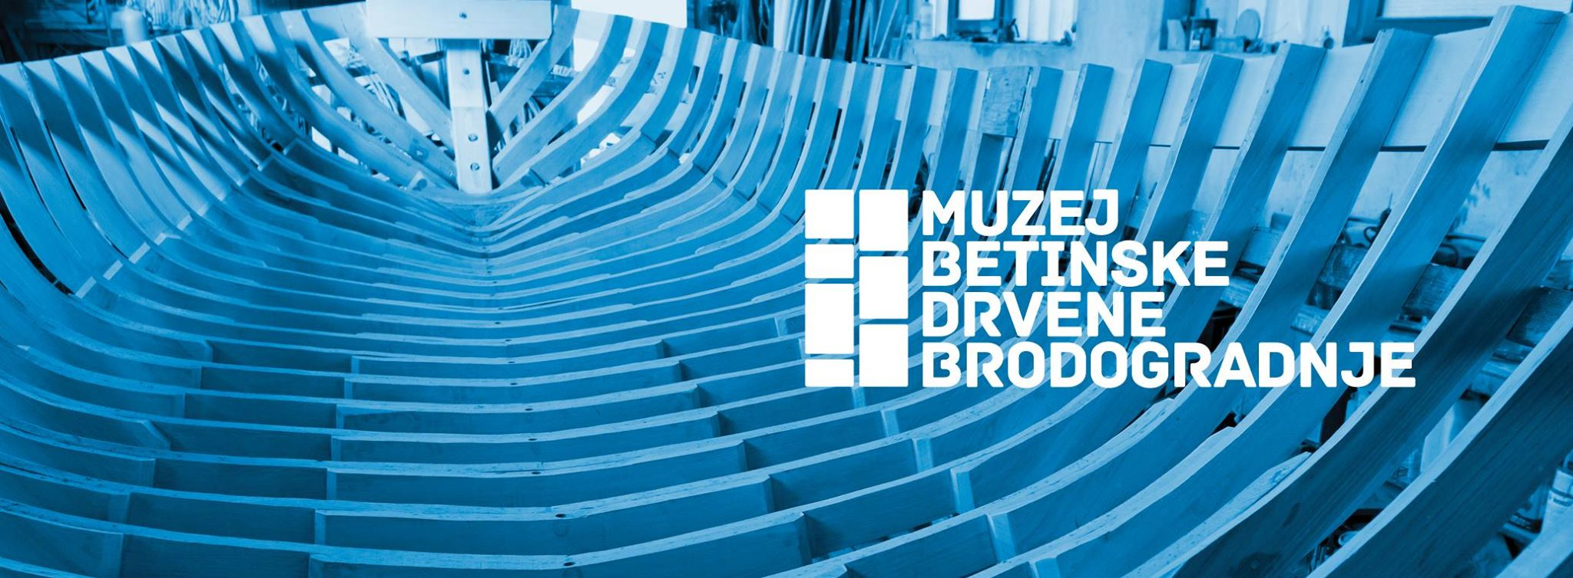

Slide 2
Brodogradnja u Betini:
obitelji Filipi i Uroda doseljavaju u
Betinu sredinom 18. stoljeća
Shipbuilding in Betina:
Filipi and Uroda families settle in
Betina in the middle of 18th century

Slide 3
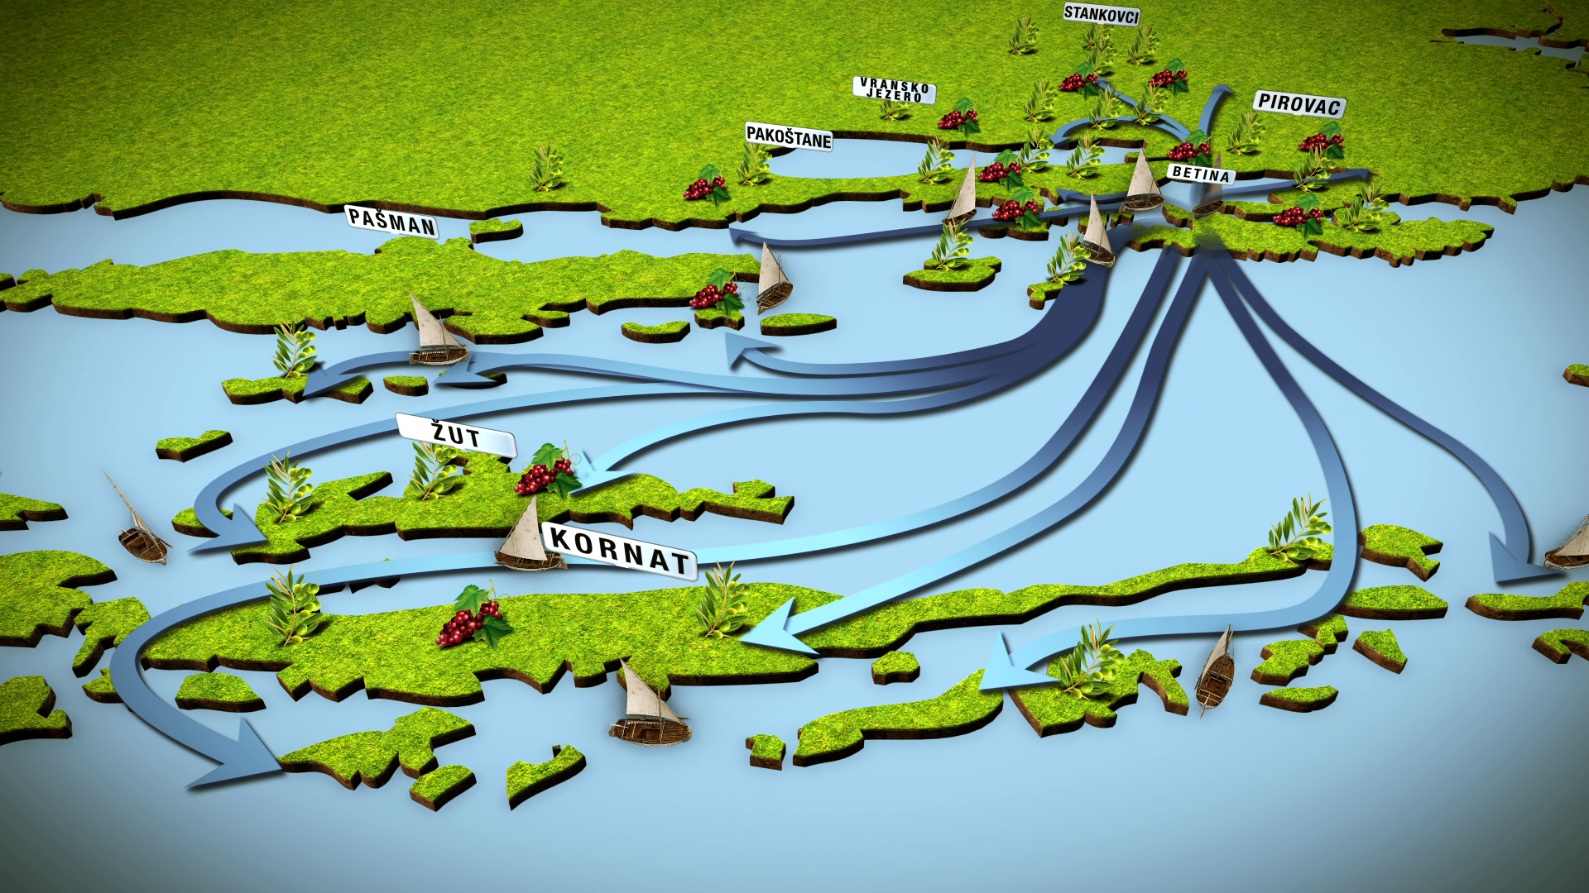
Posjedi stanovnika Murtera i Betine
Properties of inhabitants of Murter and Betina

Slide 4
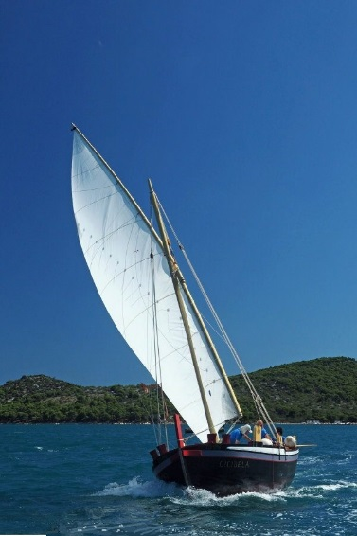
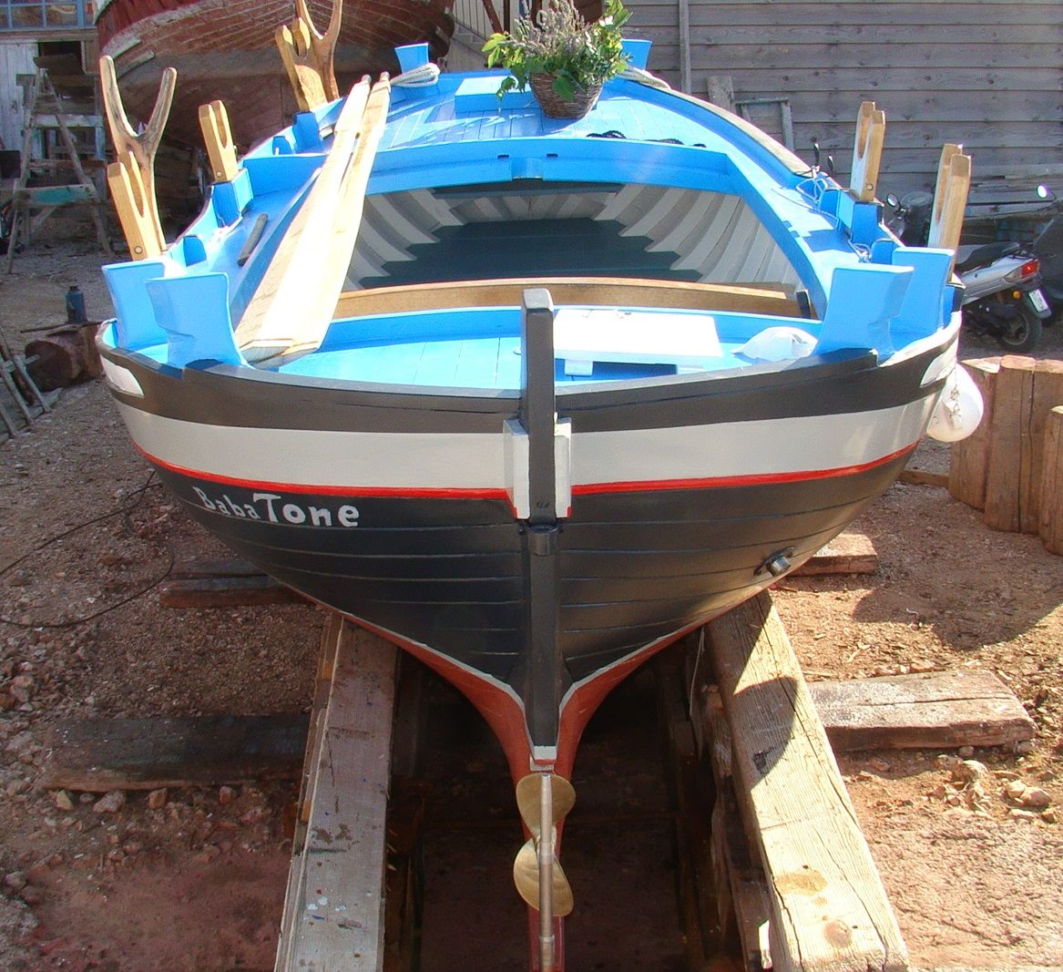
Betinska gajeta
Betina gajeta

Slide 5
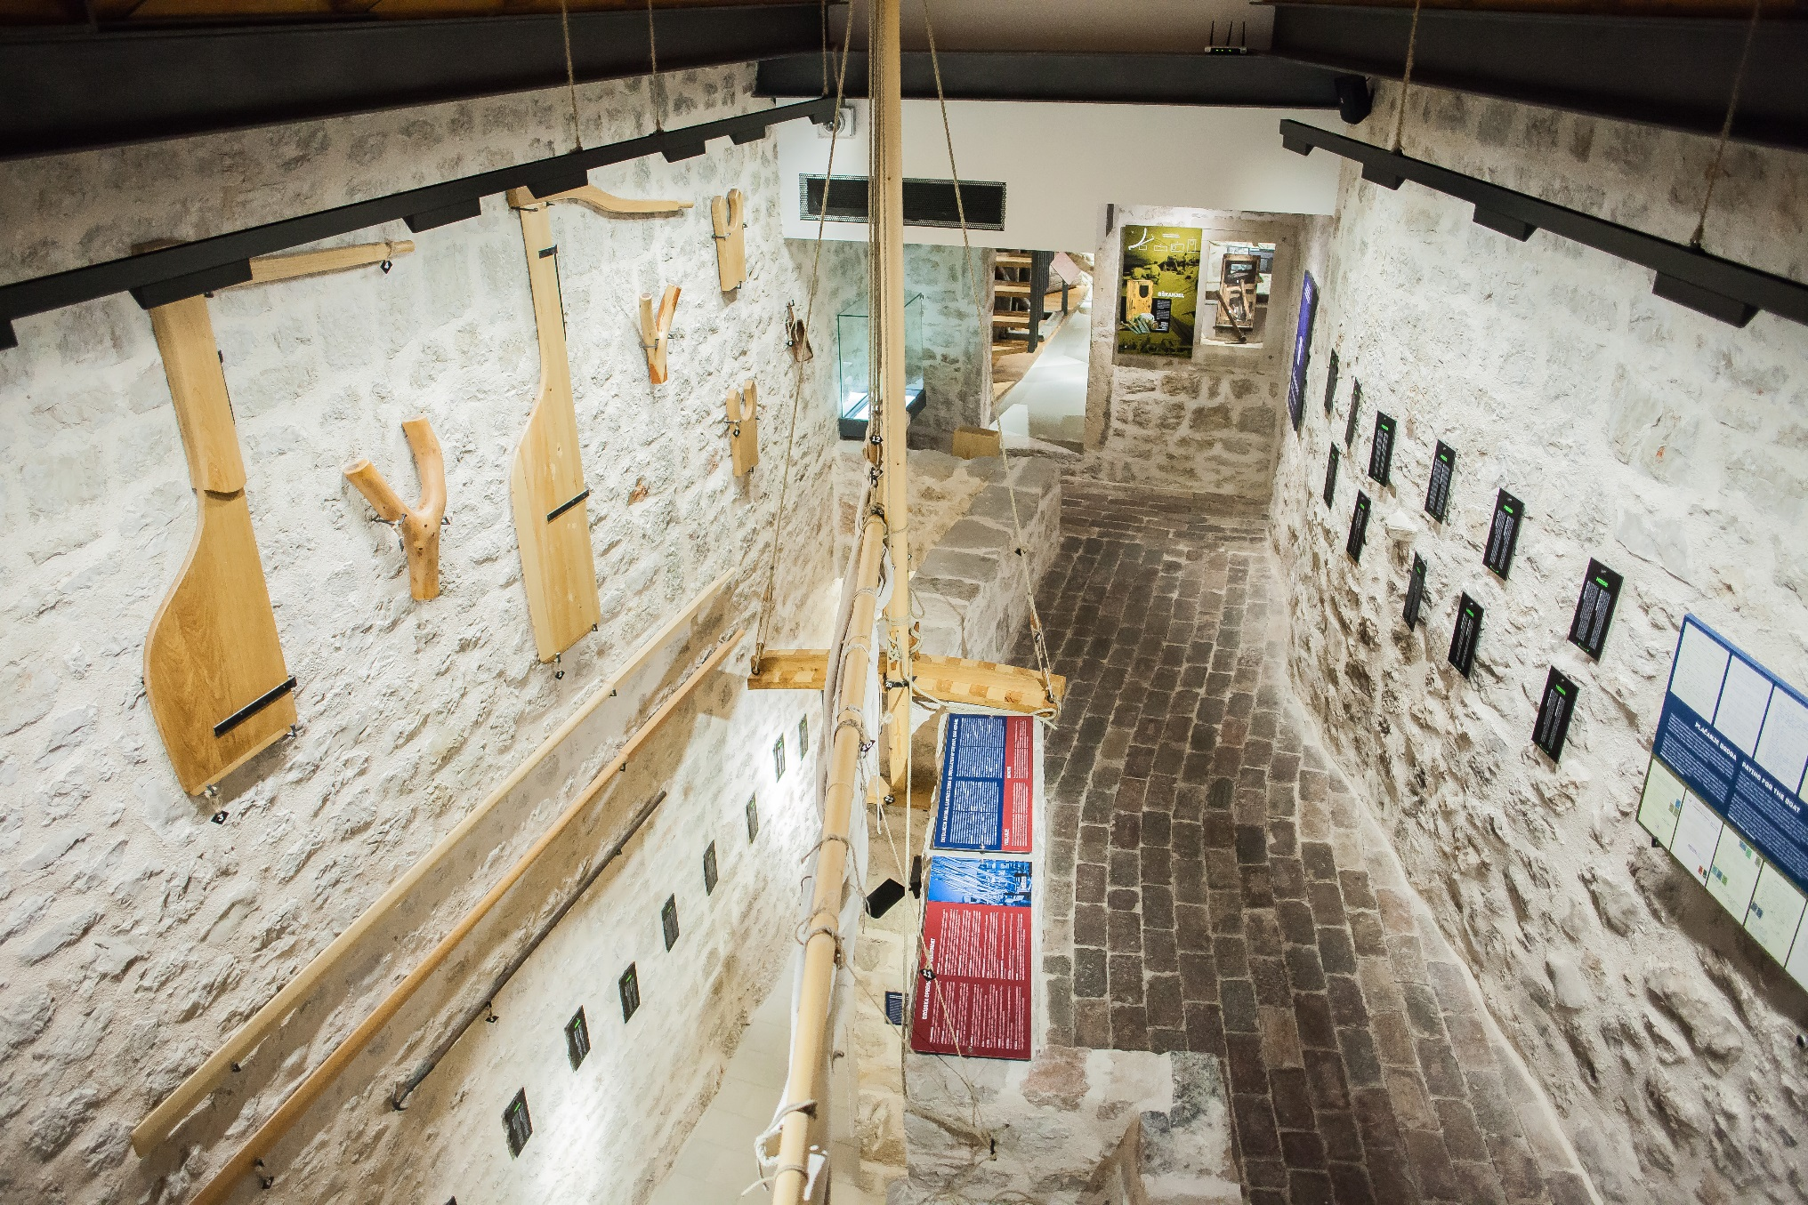
Muzej betinske drvene brodogradnje, otvoren 2015. godine
Betina Museum of Wooden Shipbuilding, opened in 2015

Slide 6
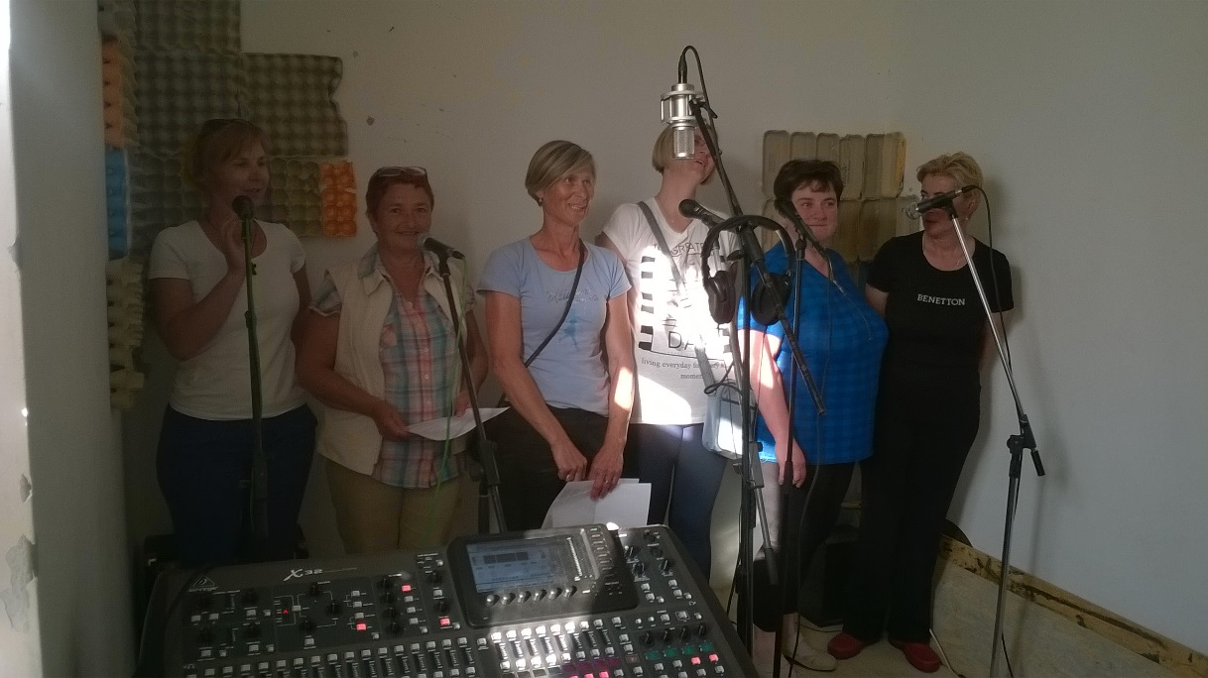
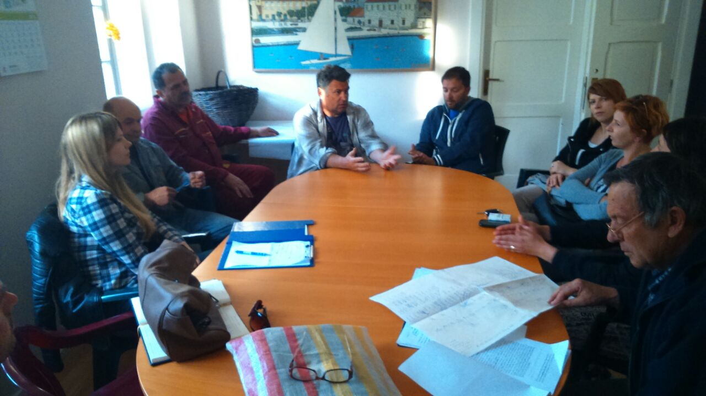
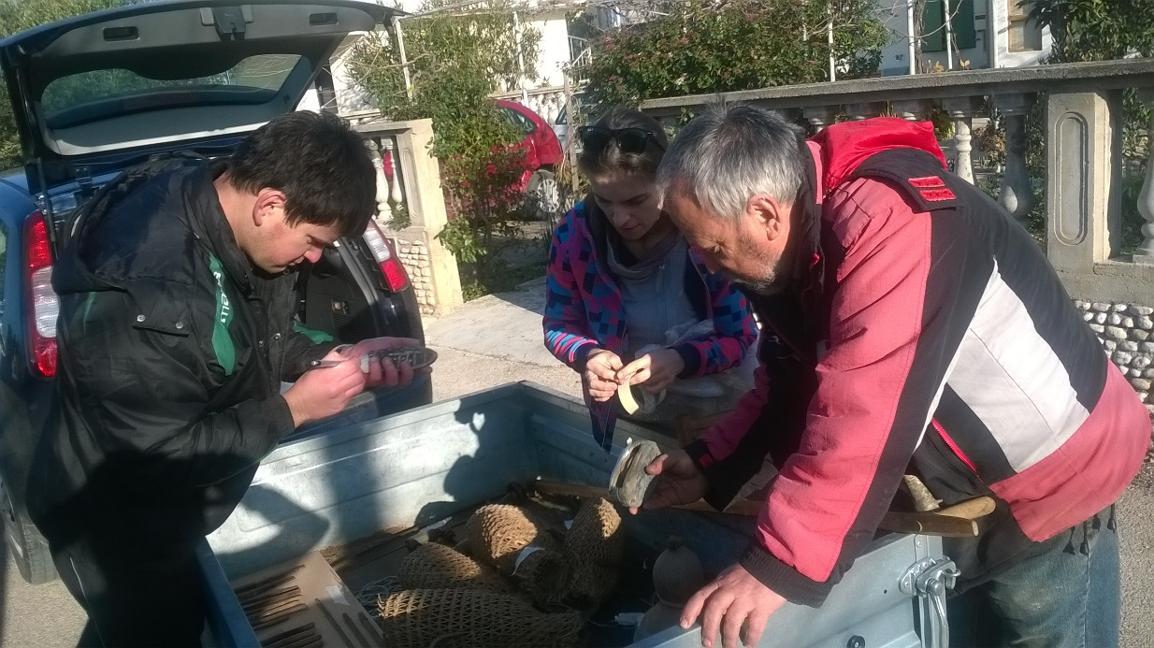
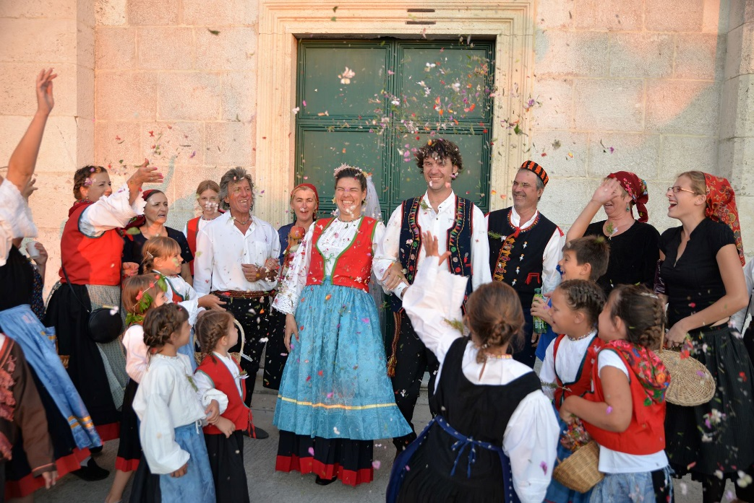
Uloga lokalne zajednice u stvaranju Muzeja
The role of local community in the process of creating the Museum

Slide 7
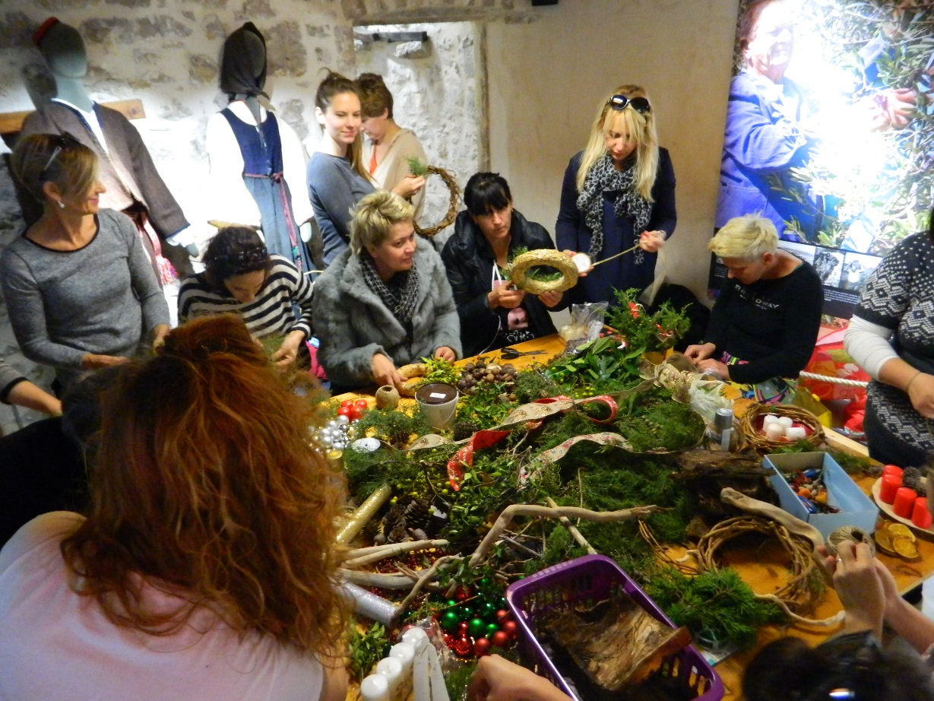
Uloga Muzeja u životu lokalne zajednice
The role of the Museum in everyday life of local community

Slide 8
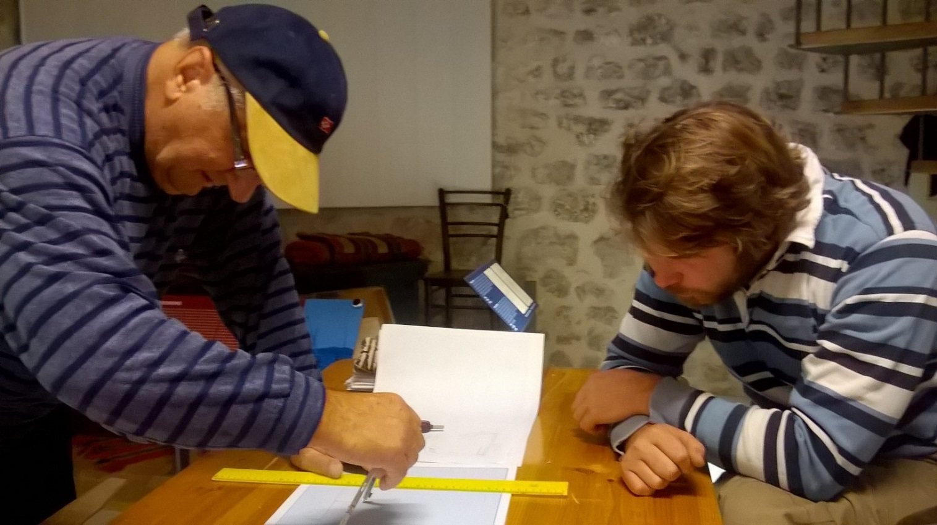
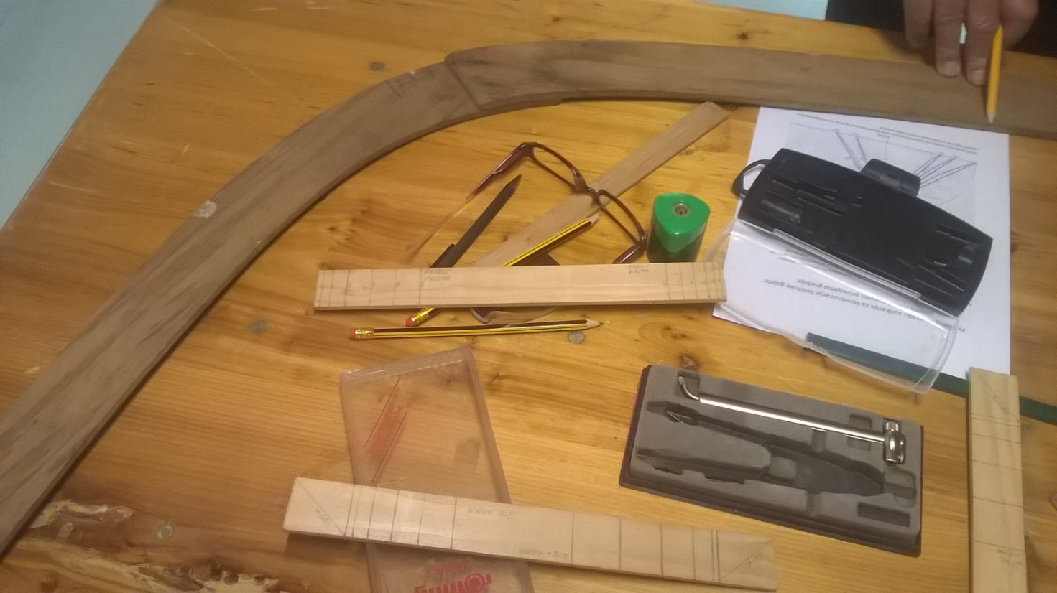
Prenošenje znanja
Transfer of knowledge

Slide 9
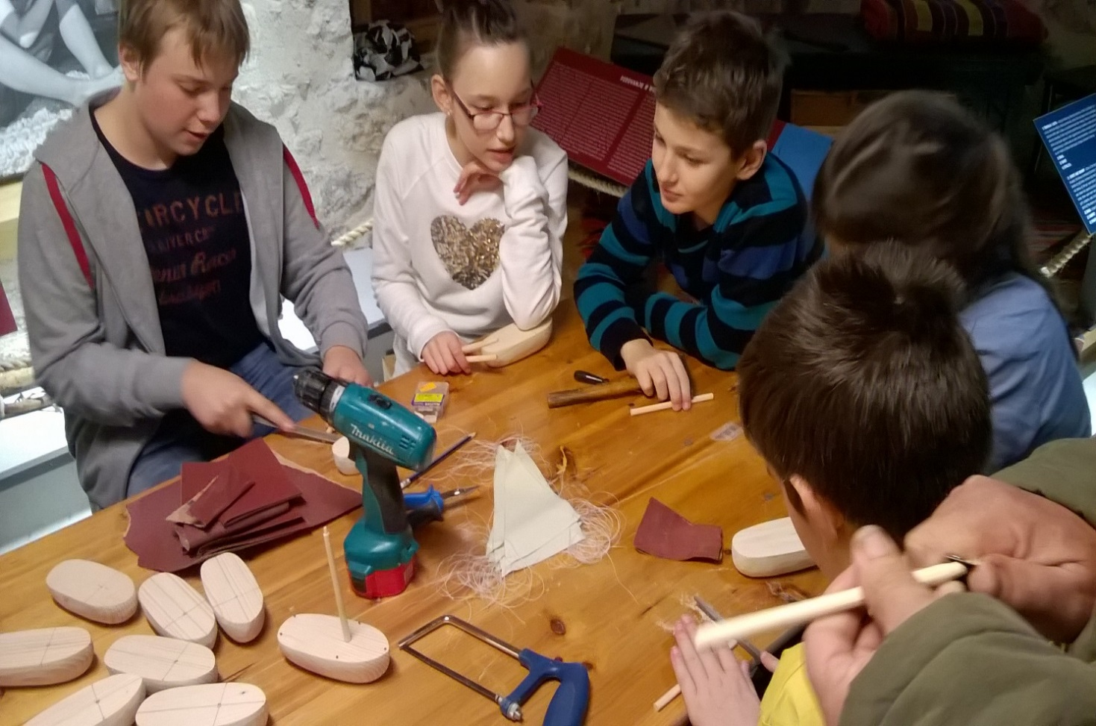
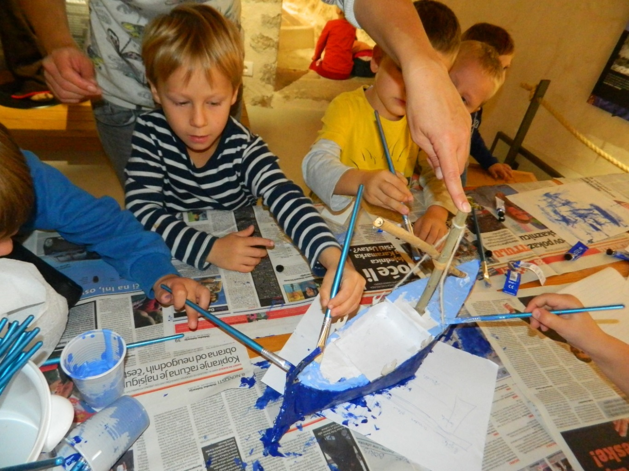
Muzejske radionice
Museum workshops

Slide 10
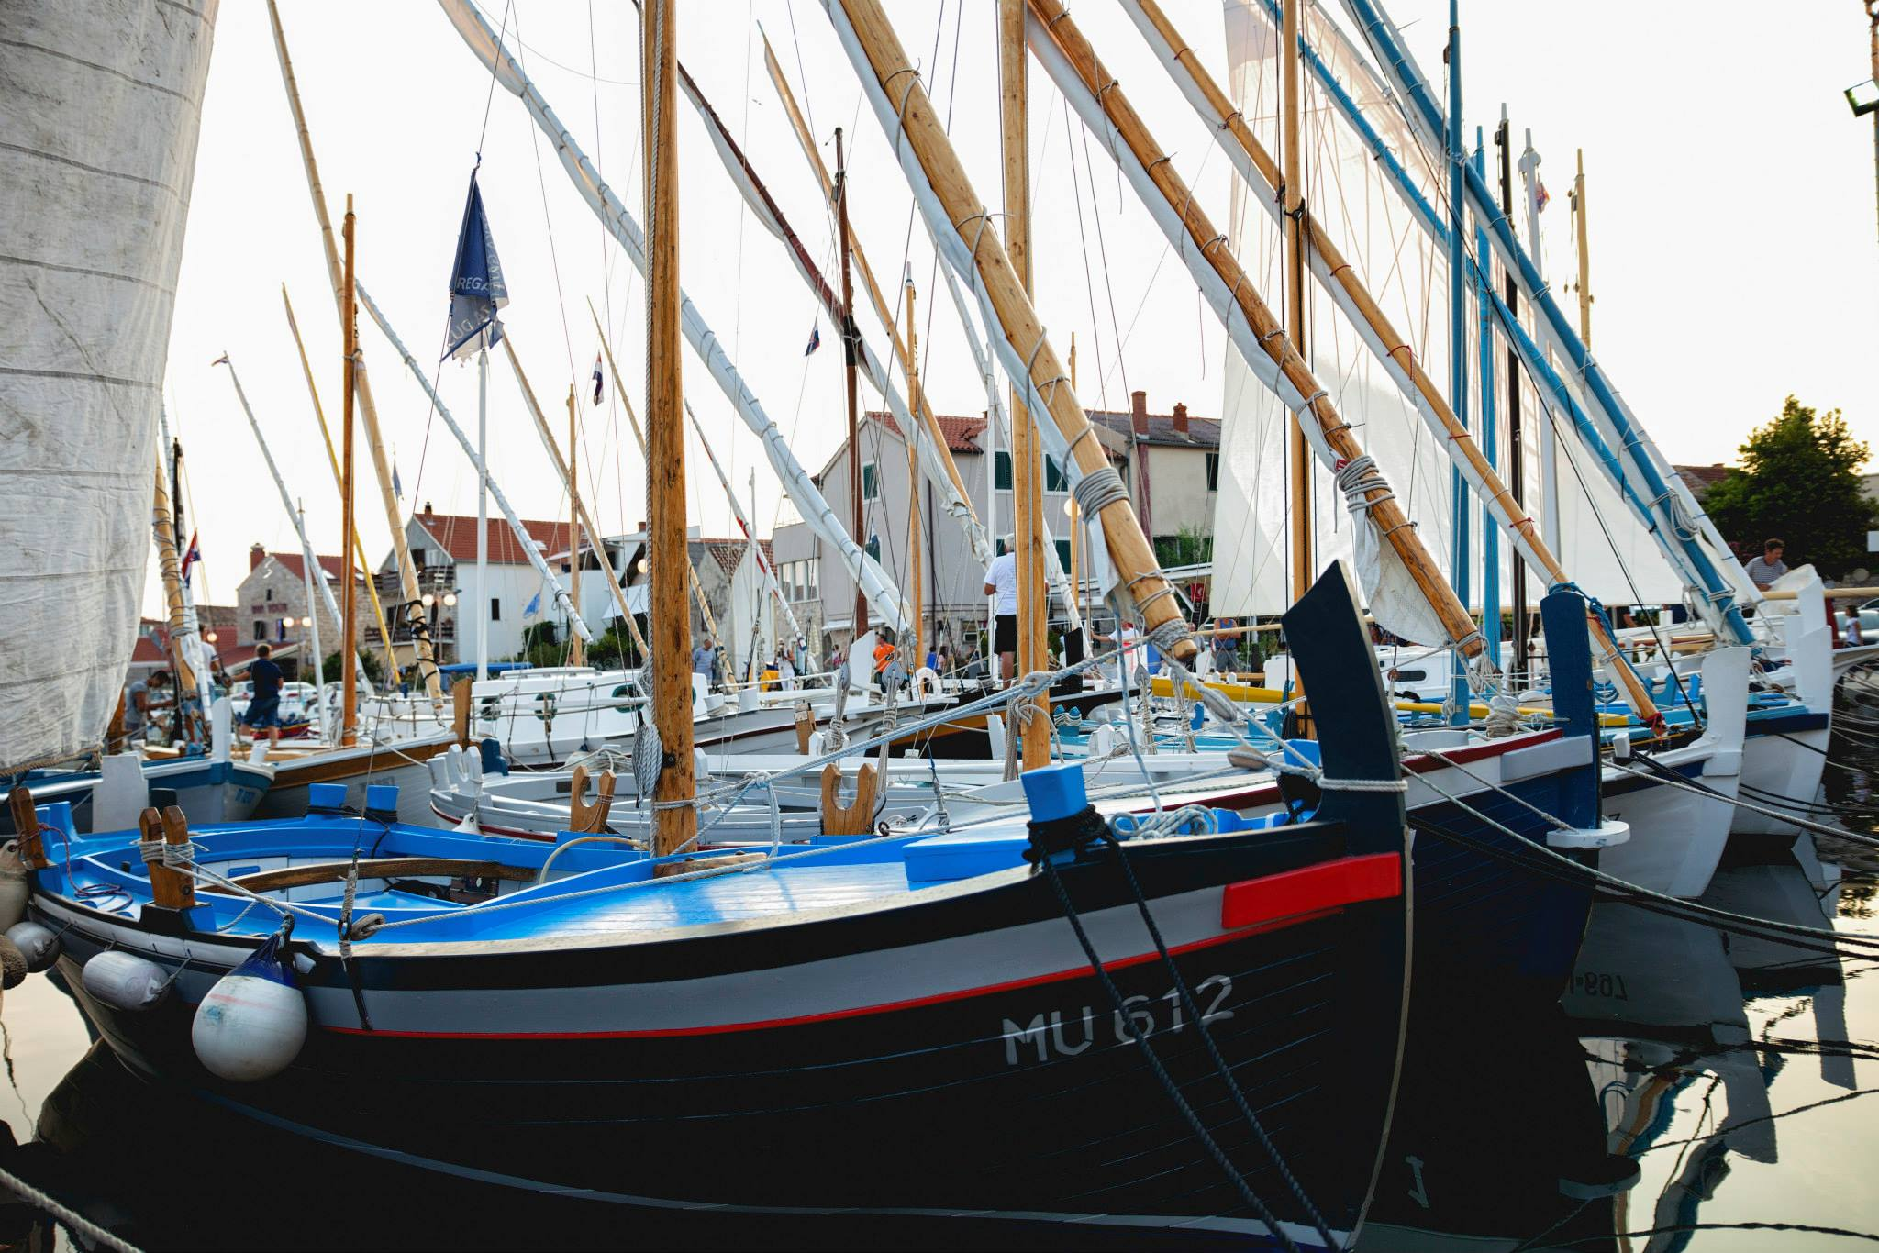
„Muzej izvan zidova” / „The open air museum”

Slide 11
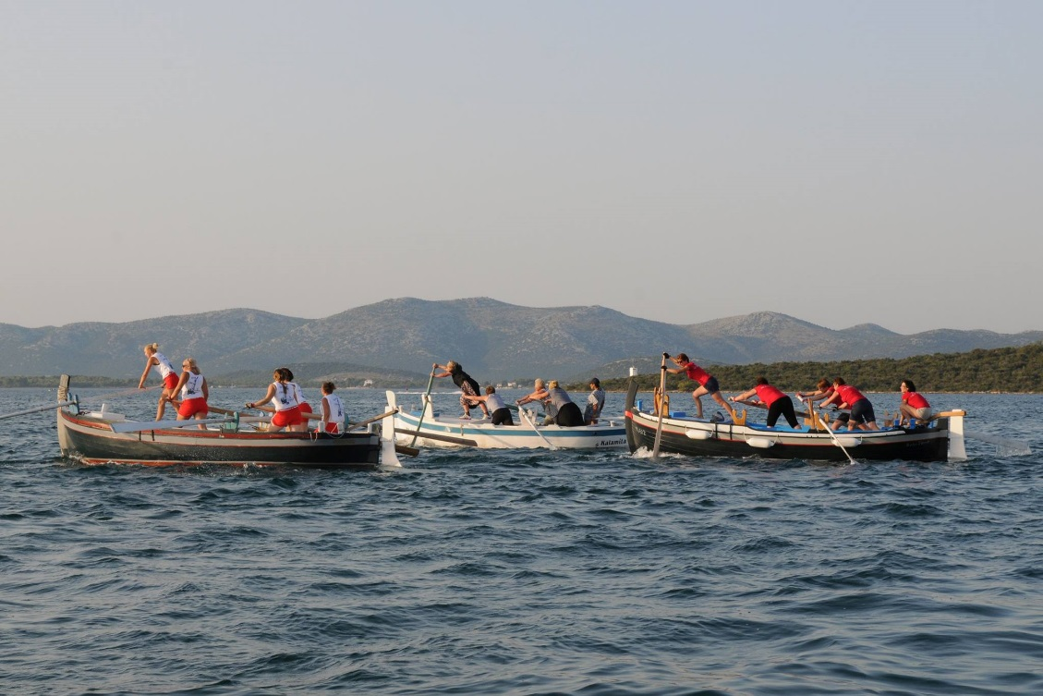
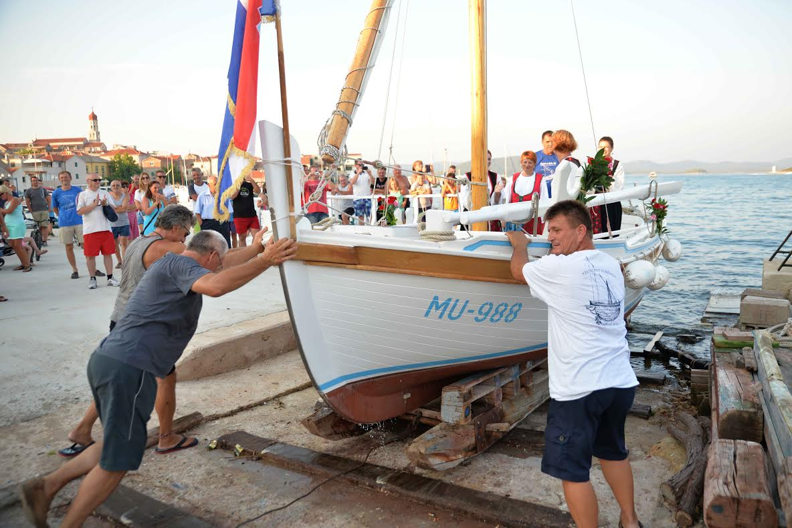
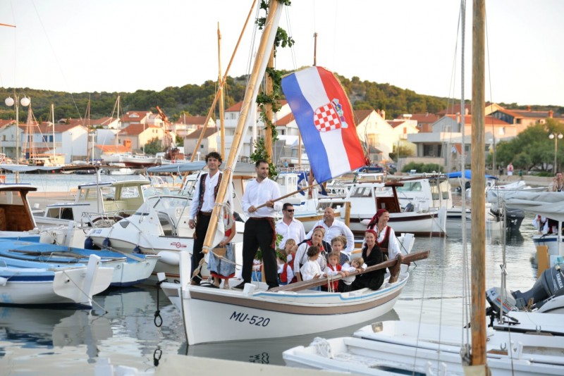
Kulturno-zabavna događanja
Cultural and entertainment events

Slide 12
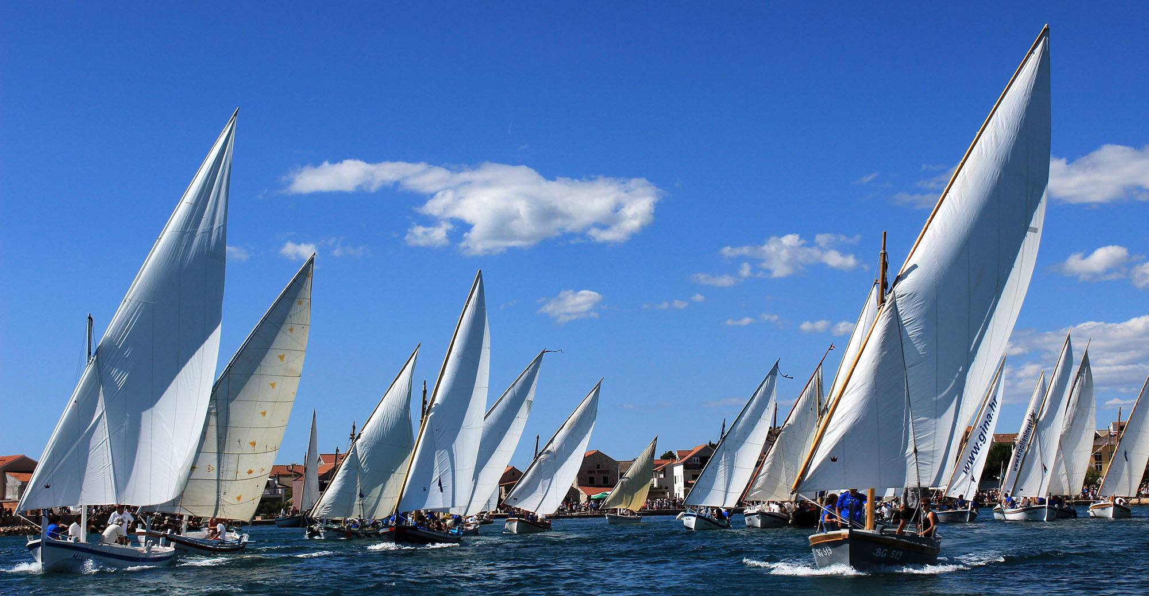
Hvala / Thank you

